Slide 1


BAN6440: Applied Machine Learning
Milestone Assignment Two
Title: MD Anderson Cancer Institute Cancer Diagnosis using ANNs
Name: Mubanga Nsofu
Learner ID: 149050
Date: 10th December 2024
Lecturer: Professor Bucciarelli

Slide 2
Problem Understanding
Overview
Predict if a breast tumor was Benign or Malignant using ANNs
Standard metrics to benchmark the performance of the ANN
Draw conclusions based on the results
CRISP-DM was applied to ensure no steps were missed in Applied ML
Objective
Methodology
Results
Conclusions
The key objective was to implement a binary classification model to predict whether breast cancer is benign or malignant using the Breast Cancer Wisconsin dataset, obtained from Kaggle.
An Artificial Neural Network (ANN) was built using Keras, a high-level API of TensorFlow.
During the process, it was ensured that data preprocessing and evaluation were robust, including techniques like k-fold cross-validation for more reliable performance metrics.

Slide 3
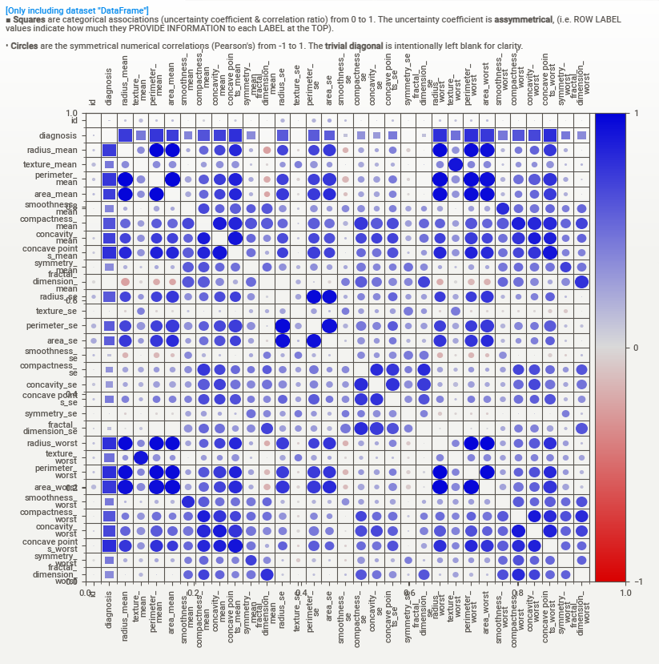
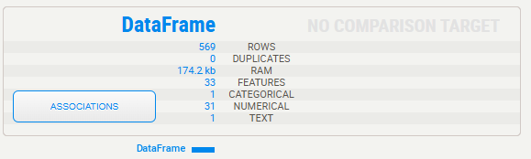
Data Preprocessing
Before data preprocessing, exploratory data analysis (EDA) was done using the SweetViz library.
The snippets show Associations on the left and details of the data frame on the top
569 observations, with no duplications, a total of 33 features ( 1 categorical, 1 text and 31 numerical)
The EDA approach helped identify two irrelevant columns ( “Unnamed:32” and “id”), understand the target variable (diagnosis), which needed to be one hot encoded, and the numerical variables needed to be scaled since they had different magnitudes. These were dealt with during the preprocessing phase

Slide 4
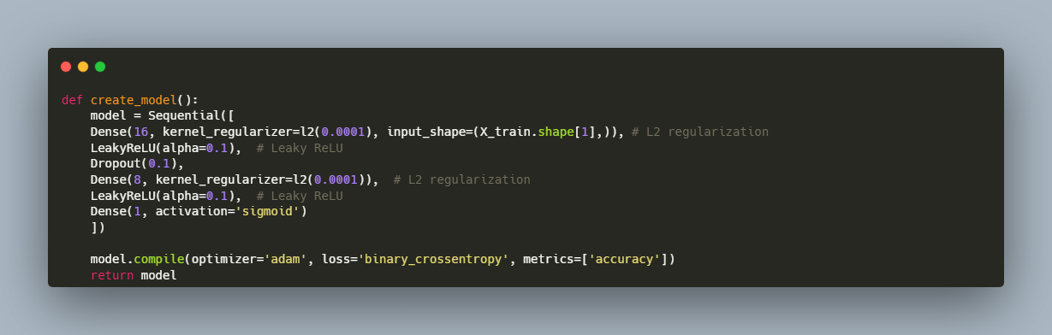
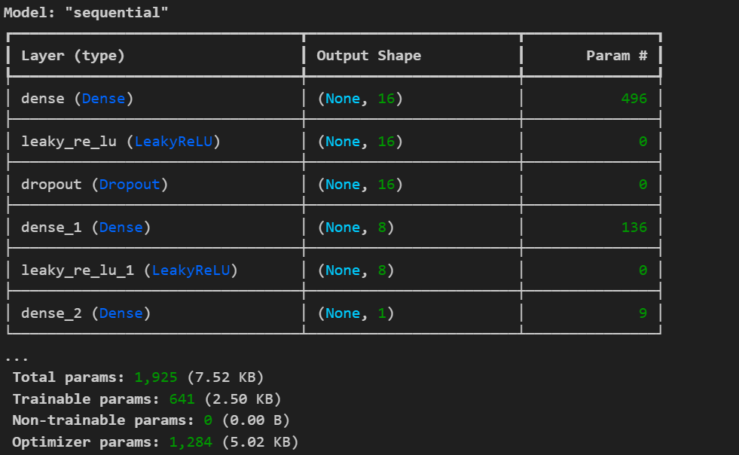
Model Development
Model development was based on the Keras API, as the code snippet shows.
The architecture is shown as well
The ANN includes Dense layers: with 496 parameters in the first layer, 136 in the second, and 9 in the final layer
The ANN has two Leaky ReLU activation functions for non-linearity
The architecture also incorporates Dropout and L2 regularization to prevent overfitting
Finally, a Sigmoid activation is incorporated in the output layer since the problem is a binary classification.
The model is compiled using Adam optimizer and binary cross entropy loss

Slide 5
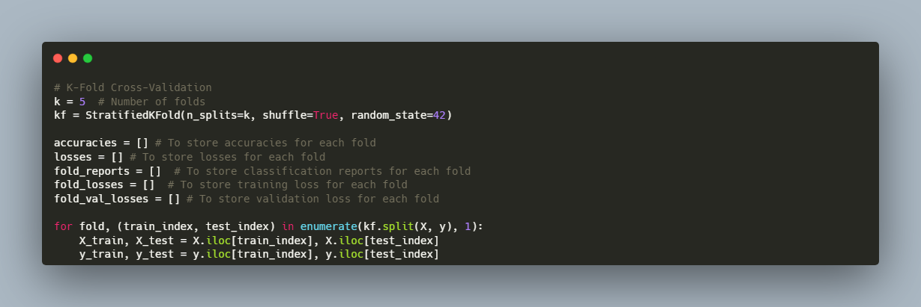
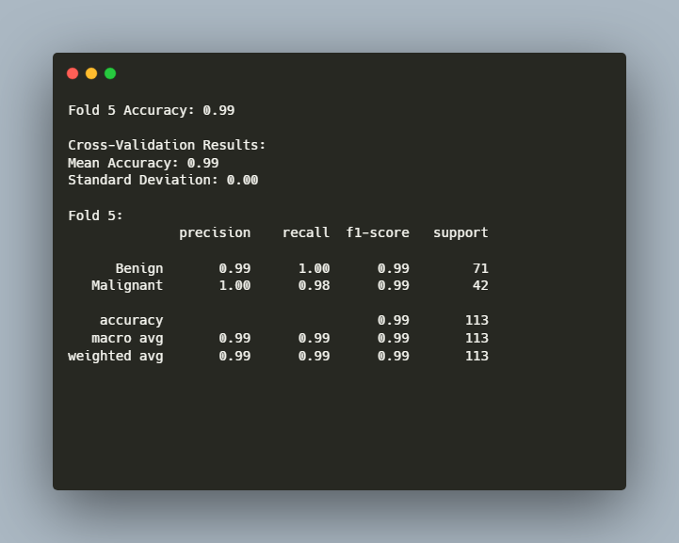
Model Training and Evaluation [1/2]
k-fold cross-validation (5 folds) was used to evaluate the model’s generalization
For each fold, training and validation losses, as well as training and validation accuracy was tracked
K-fold cross-validation is essential as it helps to prevent overfitting. In addition, neural networks are stochastic and as such, multiple runs to evaluate the model’s skill
In addition, classification reports (precision, recall, F1-score and support) were generated for both classes
The mean accuracy is 99% as shown in the snippet on the left

Slide 6
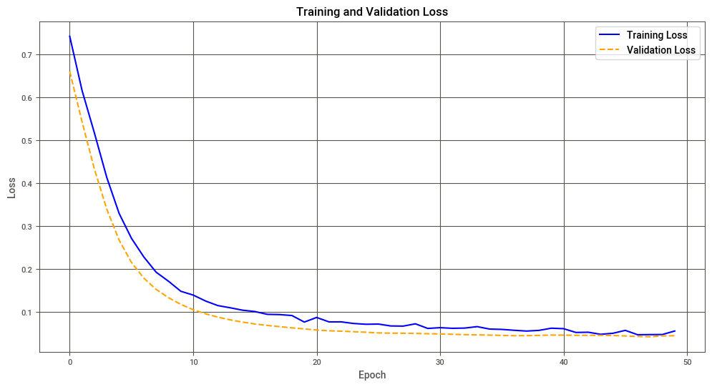
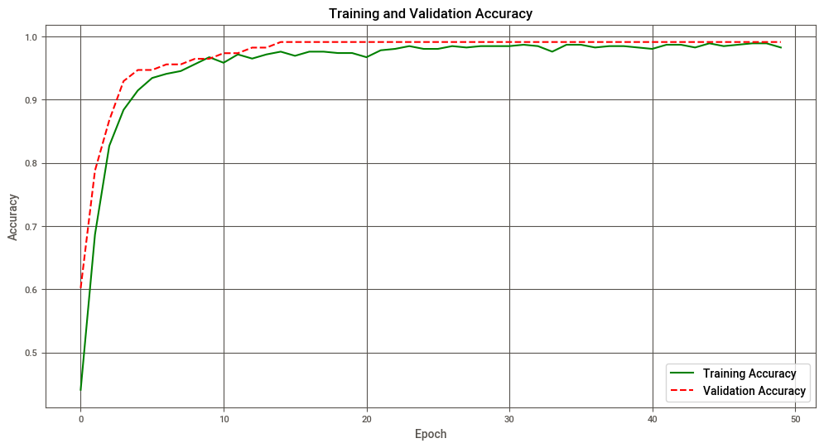
Model Training and Evaluation [2/2]
The training and validation loss decreases during each epoch
The training and validation accuracy improves every epoch
The validation accuracy is better than the training accuracy, suggesting the model generalizes well on unseen data

Slide 7
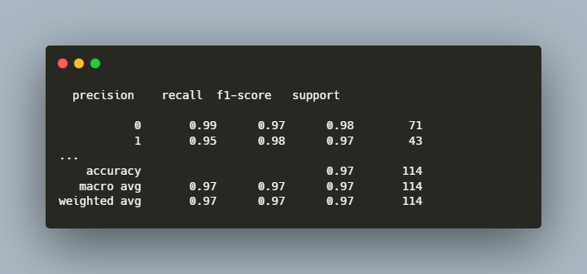
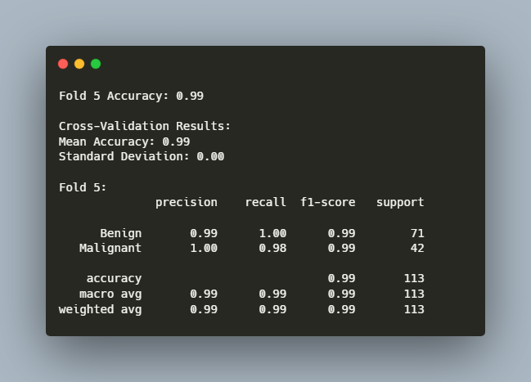
Challenges Faced and Solutions
Main challenges encountered during the training process and solutions implemented
GOAL
Challenge: Imbalance in class distribution
Initially, I tried SMOTE to balance the dataset.
1
Challenge: Training loss higher than validation loss
Solution: Observed SMOTE degraded the model’s performance and turned to k-fold cross-validation instead
This was caused by dropout and regularization impacting training but not validation
2
Challenge: Blank plots for loss/accuracy visualization
Solution: Retained regularization to avoid overfitting after I understood the model’s generalization was the priority
Loss and accuracy data was not appropriately captured in some iterations
3
Solution: I debugged history.history dictionary to ensure correct storage of training and validation metrics
No Cross-Validation
5-Fold Cross-Validation
The three main challenges are listed above
The example on the left shows the impact of cross-validation in proving the model’s performance
Note: SMOTE (Synthetic Minority Oversampling Technique)

Slide 8
Summary Performance [1/3]
 | No 5-Fold CV
 | Precision | Recall | F1-Score | Support
Benign | 99% | 97% | 98% | 71
Malignant | 95% | 98% | 97% | 43
Accuracy |  |  | 97% | 113
Macro Avg | 97% | 97% | 97% | 113
Weighted Avg | 97% | 97% | 97% | 113
 | With 5-Fold CV
 | Precision | Recall | F1-Score | Support
Benign | 99% | 100% | 99% | 71
Malignant | 100% | 98% | 99% | 42
Accuracy |  |  | 99% | 113
Macro Avg | 99% | 99% | 99% | 113
Weighted Avg | 99% | 99% | 99% | 113
Precision is the proportion of correctly predicted True observations of the total predicted positives.
In cancer diagnosis, the precision of the Malignant class is important. Without 5-Fold Cross-Validation, the model only has a precision of 95%. This means 5% of the Malignant cases would be misdiagnosed (detrimental to patients)
Post implementation of 5-Fold Cross-Validation, the Precision for Malignant cases is 100%
The Sensitivity(Recall) is the ratio of correctly predicted positive observations to all actual positives. Post application of 5-Fold Cross-Validation shows this metric has improved as well for both classes.

Slide 9
Summary Performance [2/3]
 | No 5-Fold CV
 | Precision | Recall | F1-Score | Support
Benign | 99% | 97% | 98% | 71
Malignant | 95% | 98% | 97% | 43
Accuracy |  |  | 97% | 113
Macro Avg | 97% | 97% | 97% | 113
Weighted Avg | 97% | 97% | 97% | 113
 | With 5-Fold CV
 | Precision | Recall | F1-Score | Support
Benign | 99% | 100% | 99% | 71
Malignant | 100% | 98% | 99% | 42
Accuracy |  |  | 99% | 113
Macro Avg | 99% | 99% | 99% | 113
Weighted Avg | 99% | 99% | 99% | 113
The harmonic mean F1-Score is 99% for both classes post a 5-fold CV, which indicates good model performance.
The support shows more true instances in the Benign class than in the Malignant class. This indicates class imbalance, which could impact model performance.
The Macro average is the average of both classes’ precision, recall and F1 score equally. This is better for the 5-fold CV model with all three metrics at 99%.
The model generally performs well, maintaining well-balanced metrics for both classes.

Slide 10
Summary Performance [3/3]
Accuracy
Precision
Model Accuracy 99% across all folds
Benign: 99%
Malignant: 100%
Insights in Model Performance
Recall
F1-Score
Benign: 100%
Malignant: 98%
Benign: 99%
Malignant: 99%
The metrics above indicate excellent performance for both benign and malignant classes
K-fold cross-validation provides a reliable assessment of the model’s consistency and prevents overfitting
Drop out, L2 regularization also effectively prevents overfitting.

Slide 11
Potential Applications in Cancer Diagnosis
Screening
Early Detection
This model can assist pathologists and radiologists by providing a second opinion in diagnosing breast cancer, especially in cases where manual diagnosis is time-consuming or ambiguous.
The application can be deployed for large scale screening to identify cases that require immediate attention
Applications
Telemedicine Applications
Continous Learning
The application can be used for remote medicine applications allowing for cancer diagnosis in rural underserved areas
DeepNets excel with Big Data. The model can be retrained to include many more features for enhanced accuracy

Slide 12
Conclusions
ANNs can be used to learn complex relationships in tabular data. In this assignment, ANNs have been used to classify Malignant and Benign tumours for MD Anderson Cancer Institute.
The model's mean Accuracy is 99% with a Precision of 100% and Recall of 98% for Malignant Cases.
The model can be extended into the realm of computer vision and include some aspects of explainability to provide interpretable results for clinicians.

Slide 13


References
Tran, K. A., Kondrashova, O., Bradley, A., Williams, E. D., Pearson, J. v., & Waddell, N. (2021). Deep learning in cancer diagnosis, prognosis and treatment selection. Genome Medicine, 13(1), 152. https://doi.org/10.1186/s13073-021-00968-x
google. (n.d.). Keras: The high-level API for TensorFlow | TensorFlow Core. Retrieved December 9, 2024, from https://www.tensorflow.org/guide/keras
Kaul, S. (2024). Building Deep Learning Models with Keras: A Step-by-Step Guide with Code Examples. Medium. https://medium.com/@sumit.kaul.87/building-deep-learning-models-with-keras-a-step-by-step-guide-with-code-examples-68aee4152625

Slide 14

Thank you!

